Slide 1
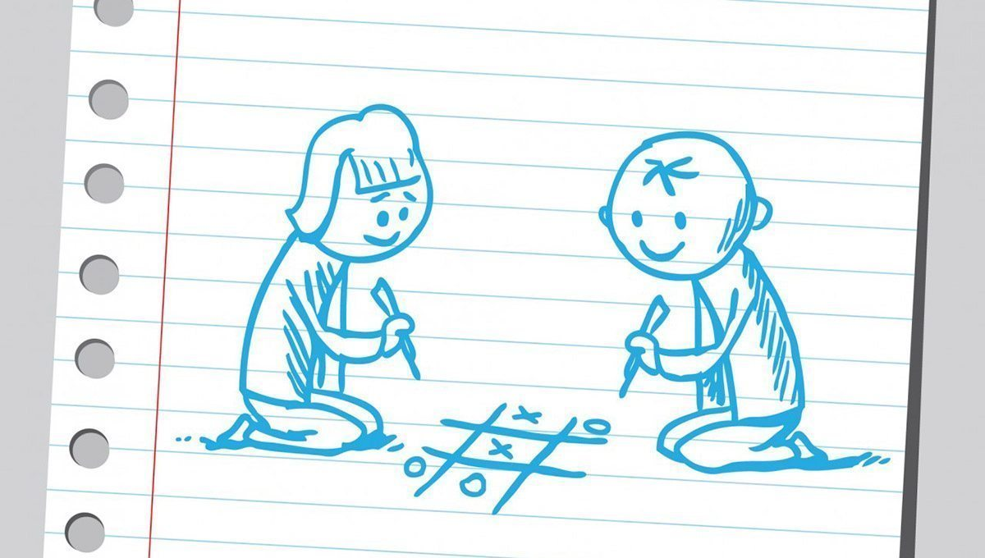
Final Task: Tic-Tac-Toe App
Vault of Codes

Slide 2
Table of Contents:
Introduction
Working
Uses
Advantages & Disadvantages
Future Scope
Conclusion

Slide 3

Introduction:
Tic-Tac-Toe application developed using the Python programming language. In this project, we have created a graphical user interface (GUI) version of the classic Tic-Tac-Toe game. Players can take turns to make their moves, and the application checks for win conditions and ties. The code for this application is built using the `tkinter` library, which is a common choice for creating graphical user interfaces in Python. This project serves as an interactive and educational example for beginners to learn about Python programming and GUI development while enjoying a game of Tic-Tac-Toe.

Slide 4
Working:
1. Importing Libraries:
- The code begins by importing the necessary libraries: `tkinter` for creating the graphical user interface and `messagebox` for displaying message boxes.
2. Initializing Game State:
- The game state is initialized with the current player set to "X," and a list called `board` representing the Tic-Tac-Toe grid with nine empty spaces.
3. Game Logic Functions:
- There are several functions defined to handle the game logic:
- `check_win(player)`: Checks if the specified player has won the game by examining various win combinations.
- `check_tie()`: Checks if the game has resulted in a tie (a draw).
- `on_button_click(button)`: This function is called when a player clicks on a game button. It updates the game state, checks for wins or ties, and switches the current player.

Slide 5
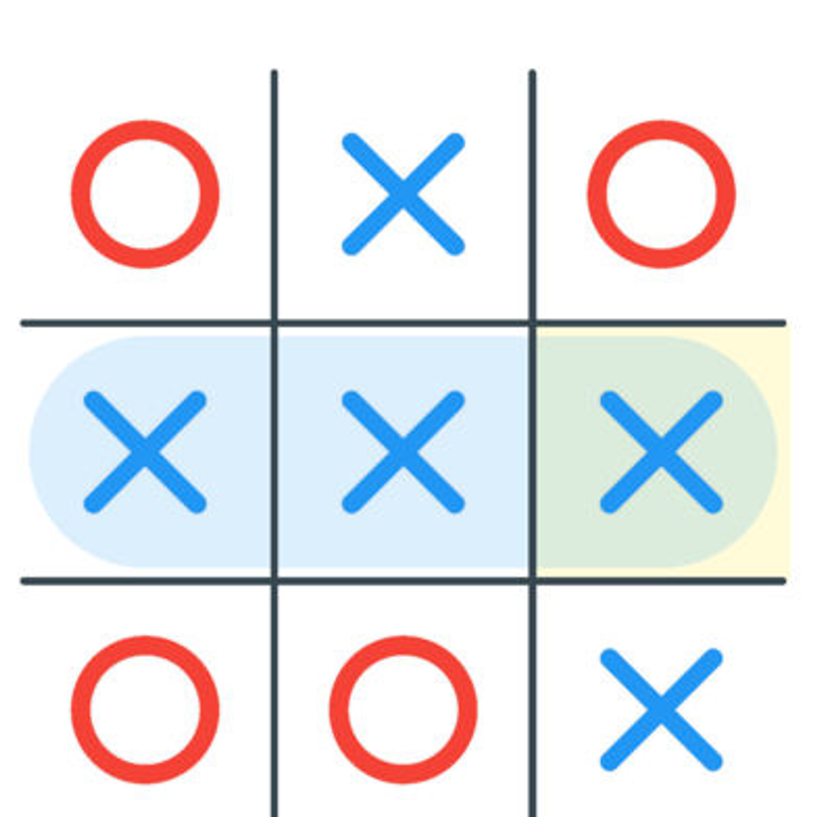
4. Resetting the Game:
- The `reset_game()` function resets the game state to start a new game. It sets the current player back to "X" and clears the game board.
5. Creating the GUI:
- The `tk.Tk()` function initializes the main application window.
- A grid of buttons is created using a for loop. Each button represents a space on the Tic-Tac-Toe board. The buttons call the `on_button_click()` function when clicked, which updates the game state.
- A "Reset" button is also added, allowing the player to reset the game at any time.
6. Main Game Loop:
- The `root.mainloop()` call starts the main event loop for the GUI, enabling the application to respond to user interactions.
- The game continues until a player wins, there's a tie, or the user closes the application.
7. Handling Wins and Ties:
- When a player wins or the game results in a tie, the `messagebox.showinfo()` function displays a message box to inform the players of the outcome. The `reset_game()` function is called to prepare for a new game.

Slide 6
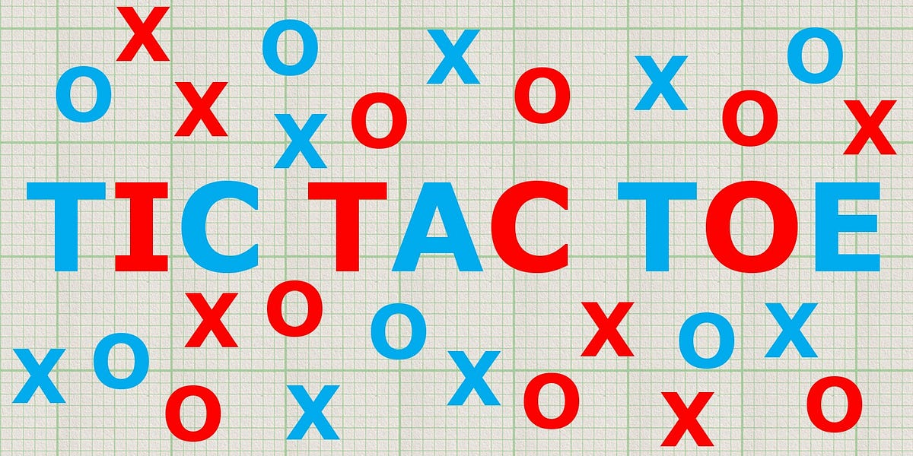
Uses:
A Tic-Tac-Toe application, whether implemented as a simple text-based game or a graphical user interface (GUI) application, serves several practical uses and applications:
Educational Tool
Recreational and Entertainment
Portfolio Project
Educational Games
Social and Multiplayer Interaction
Learning and Debugging Tool
A Tic-Tac-Toe application has a wide range of uses, from being a source of entertainment and nostalgia to serving as a valuable educational and coding resource. Its simplicity and familiarity make it an excellent choice for various applications and learning experiences.

Slide 7
Advantages & Disadvantages
Advantages:
Simplicity
Coding Practice
Entertainment
Portfolio Piece
Educational Value
Disadvantages:
Limited Complexity
Limited Learning Depth
Repetitive Gameplay
Lack of Features
Lack of Real-World Application

Slide 8
Future Scope:
Improved User Interface (UI):Enhance the graphical elements, animations, and overall user experience. Implement modern and visually appealing UI designs to make the game more engaging.
Cross-Platform Compatibility: Create versions of the game that can run on different platforms, including mobile devices, tablets, and web browsers, to reach a broader audience
Networking and Chat Features: Integrate chat features to allow players to communicate during gameplay, fostering social interaction. This can enhance the multiplayer experience.
Enhanced Sound and Audio: Add sound effects, background music, and voiceovers to create a more immersive gaming experience.
Security and Fair Play Measures: Implement security measures to prevent cheating and unfair play in multiplayer mode, ensuring a fair and enjoyable gaming environment.
Integration with Social Media: Enable users to share their game achievements and progress on social media platforms, increasing the application's visibility
The future scope of a Tic-Tac-Toe application is broad, and it can evolve in various directions to meet the preferences and expectations of users. Depending on your goals and resources, you can choose to implement one or more of these enhancements to make your Tic-Tac-Toe application more sophisticated and enjoyable.

Slide 9
Conclusion:
In conclusion, the humble Tic-Tac-Toe application, though seemingly simple, offers a world of opportunities for learning, entertainment, and development. Whether as a stepping stone for beginners to grasp programming concepts or as a platform for experienced developers to experiment with AI, this classic game project holds its own significance.
Tic-Tac-Toe serves as a valuable educational tool, teaching essential programming elements such as logic, loops, and user input handling. It can inspire creativity in UI design and gameplay customization, offering users a delightful experience.
While the fundamental Tic-Tac-Toe project provides a foundation, it can be expanded to include multiplayer capabilities, advanced AI opponents, customizable rules, and stunning graphics. These enhancements promise to make the game more engaging and exciting, attracting a broader audience and ensuring its relevance in the digital world.
As technology advances, the future scope of Tic-Tac-Toe applications holds the promise of even greater improvements, including cross-platform compatibility, localization, and accessibility features. These advancements will enable the game to reach a global audience, transcending boundaries and bringing people together in the spirit of competition and camaraderie.
In its simplicity, the Tic-Tac-Toe application embodies the essence of problem-solving, creativity, and fun. It is a testament to the potential for innovation, education, and entertainment that can be found within the confines of even the most basic of games.

Slide 10

by K.Mohan Sai Teja
Email:k.mohansaiteja112233@gmail.com

